Slide 1


Slide 2
COMPLIANCE WITH 911 FUNDING REQUIREMENTS
To meet this legislative requirement, PEMA may implement the following process to compel a PSAP to establish compliance with payment, eligibility and reporting requirements:
Notification of noncompliance: PEMA will send this notice to the PSAP. The PSAP is required to provide a written response that explains the actions to be taken to establish compliance.
For continued noncompliance or failure to complete Step 1: PEMA will send a second notice to the PSAP and elected officials. The PSAP is required to provide a written response that explains the actions to be taken to establish compliance.
For continued noncompliance or failure to complete Step 2: The PSAP will be ineligible to apply for, or be included in, new statewide interconnectivity funding grants.
For continued noncompliance after Step 3: The PSAP will be ineligible to apply for, or be included in, new statewide interconnectivity grants or receive payments from existing grants.
For continued noncompliance after Step 4: The PSAP will not receive disbursements from the 911 Fund in accordance with § 5306.1. (c) (2).

Slide 3
Formula-Based Funding (83%)
2023 Overview
Impact of the NG911 project on Formula-Based Funding
*************************
Call delivery costs pd by PEMA 15%
Counties will have more 83% funds to use due to the savings.
Funding formula assistance will continue in 2023
***********************
15% funds will be used
to offset the (-) revenue adjustment
Temporary practice

Slide 4
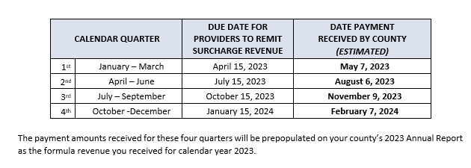
2023 Formula-Based Payment Calendar

Slide 5
Statewide Interconnectivity Funding (15%) - 2023 Overview
2023 Statewide Interconnectivity Funding Allocations
STEP 1 - By April 15, 2023: Define initiatives and costs for consideration in the 2023 15% funding cycle. The following items will be considered when planning and budgeting allocations of 15% funds for 2023 and subsequent years:
NG911 Service Contract Costs for CY 2023
Funding formula assistance for CY 2024
PEMA will work with county partners and the 911 Advisory Board to define shared system maintenance costs and other targeted projects and costs for consideration
      Shared System Maintenance Costs: The Plans By Cost Type – Detailed Projections and Anticipated Changes Sections of 911 System Plan submissions will be leveraged to identify shared system maintenance costs for consideration. Please be aware:
      NG911 Service Enhancement Request Forms (SERF): As part of the NG911 project, it is anticipated counties and other public safety stakeholders will be interested in pursuing NG911 system enhancements such as leveraging the statewide ESInet to support ancillary services, PSAP consolidations, adding a new end point to the ESInet, or other new projects. A SERF must be submitted by April 15, 2023 in order for the enhancement or new project to be considered for 15% funding in 2023. Counties are urged to closely review the NG911 Service Enhancement Roadmap Development Process in Appendix A for details related to the submission of a SERF.
PEMA may identify other targeted initiatives during planning and budgeting efforts.

Slide 6
Statewide Interconnectivity Funding (15%) - 2023 Overview
2023 Statewide Interconnectivity Funding Allocations
STEP 2 - By August 31, 2023: Allocations of 15% funds for the 2023 15% funding cycle will be finalized by PEMA in consultation with the 911 Advisory Board.
STEP 3 - Any remaining 15% funding, after statewide NG911 system costs and allocations for targeted projects are encumbered, will be distributed via a formula-based payment.

Slide 7
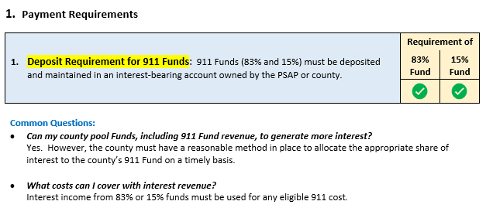
2023 911 Program Requirements
AND COMMON QUESTIONS

Slide 8
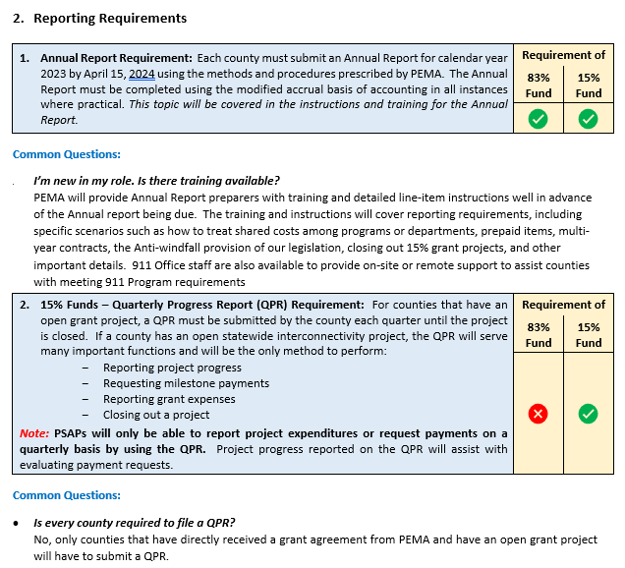
2023 911 Program Requirements
AND COMMON QUESTIONS

Slide 9
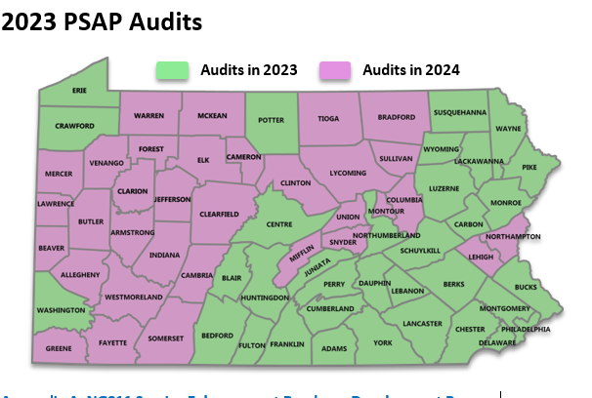

Slide 10
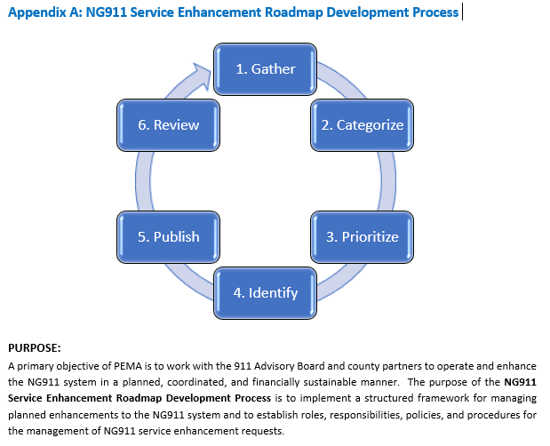

Slide 11
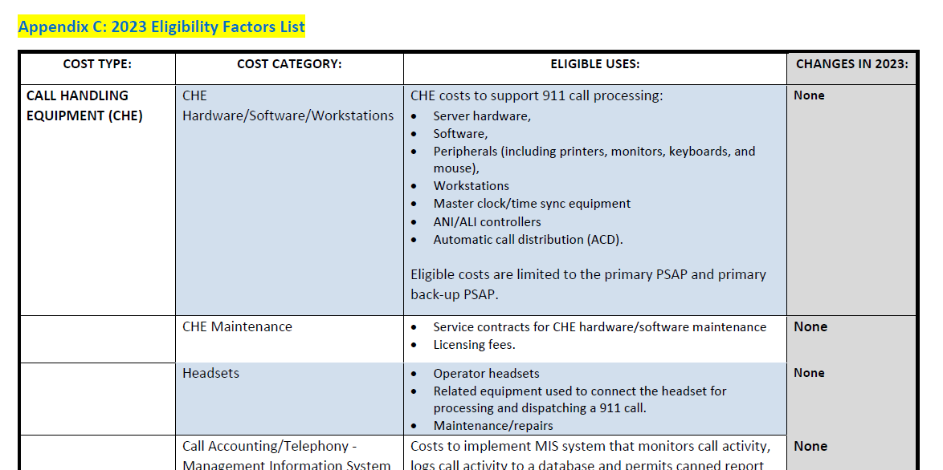

Slide 12
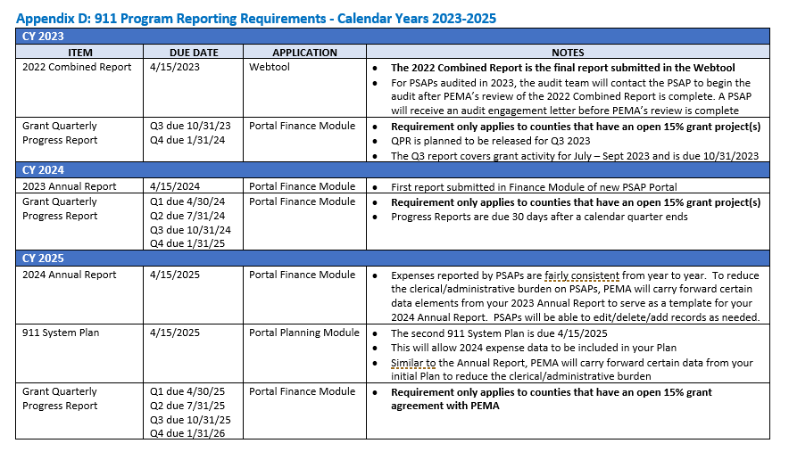

Slide 13
QUESTIONS?
PEMA Administrative Team is always available to assist you with any questions.
      PHONE
      E-MAIL
      TEAMS MEETINGS
      SITE VISITS
      THANK YOU FOR ALL THAT YOU DO!

